Slide 1



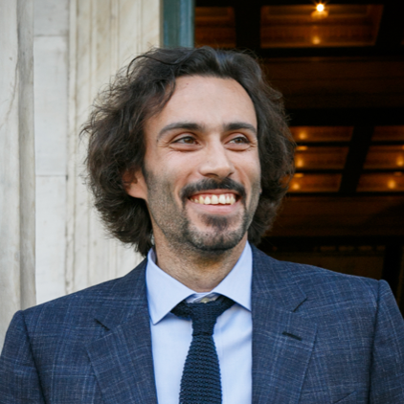
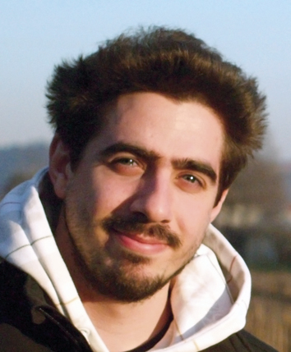
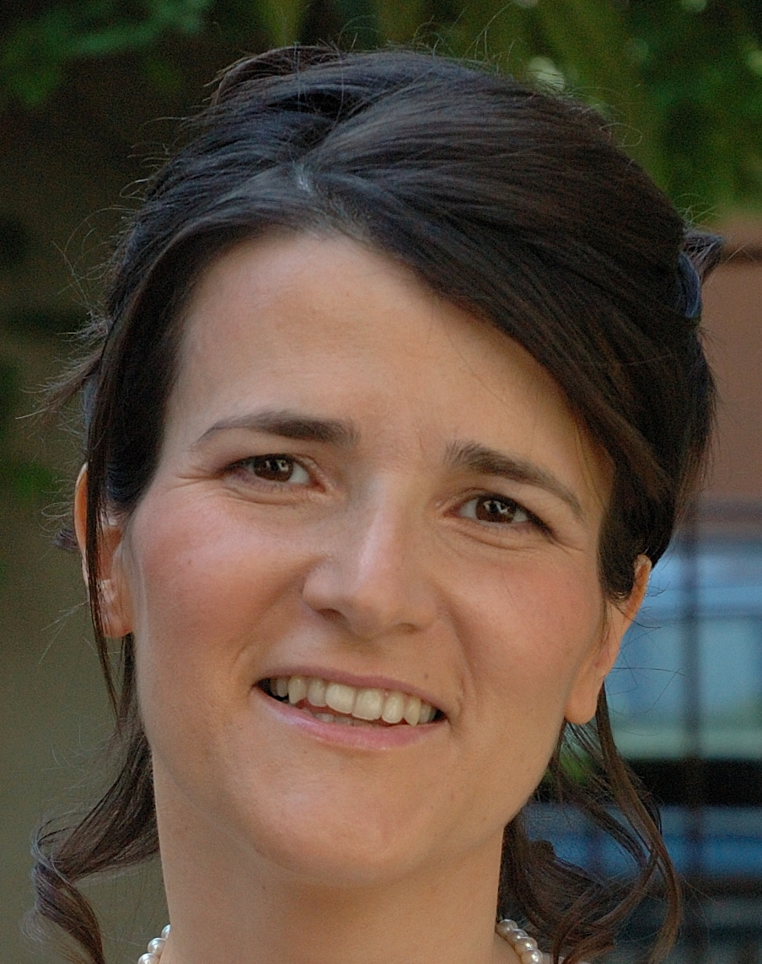
2024
International Graduate School on Control
www.eeci-igsc.eu
M01 OXFORD 12/02/2024-16/02/2024 | Coordination and Optimal Operation of Complex Systems: Theory and Applications
Kostas Margellos
University of Oxford
https://eng.ox.ac.uk/people/
kostas-margellos/
Alessandro Falsone
Politecnico di Milano https://falsone.faculty.polimi.it/
Maria Prandini
Politecnico di Milano
https://prandini.faculty.polimi.it/
Summary of the course
Current operations in energy and transportation are experiencing a transition to new operational paradigms that exhibit certain complexity features. Complexity involves challenges associated with: (i) coordinating operations among heterogenous interacting entities without sharing information considered as private; (ii) robustness against uncertainty; (iii) the ability to deal with an interplay of continuous and discrete scheduling decisions. This course provides a theoretical and computational framework for coordination and optimal operation of complex systems, addressing the aforementioned features of complexity. We first draw motivation from the energy sector, formalizing several of the current operational challenges as multi-agent optimal control and optimization problems. We then introduce and analyze a portfolio of algorithms capable to deal with the three main complexity pillars, with emphasis on distributed optimization over networks, addressing also the case where both continuous and discrete decisions are involved. Finally, we consider the case where uncertainty affects the underlying systems and show how data-driven algorithms based on statistical learning theory and randomized optimization can be extended to a multi-agent setting.
Course outline
1. Motivation of decision making in complex systems
• Energy systems operations: Aggregation of distributed energy resources; demand response; electric vehicle scheduling; building energy management
2. Mathematical preliminaries on optimization and iterative algorithms
3. Distributed algorithms for multi-agent decision making
Continuous domains: Primal-based algorithms (proximal methods; projected sub-gradient methods) and primal-dual algorithms (distributed alternating direction method of multipliers; distributed dual decomposition) for constrained optimization over networks.
Discrete domains: Primal-dual algorithms for resource sharing problems
4. Data-driven algorithms for optimization under uncertainty
• The scenario approach to optimization under a learning theoretic lens
• Probabilistic robustness in multi-agent decision making problems
5. Research vistas

Slide 2
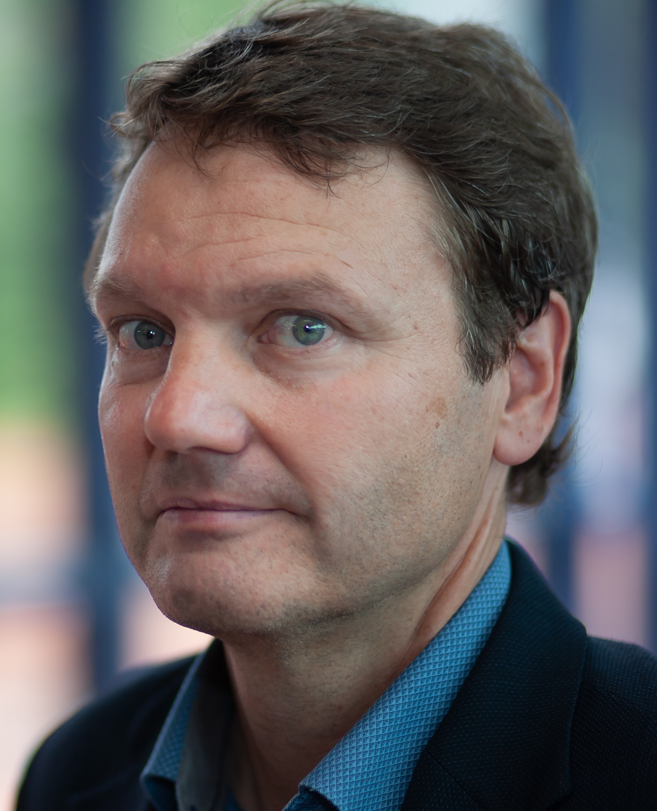
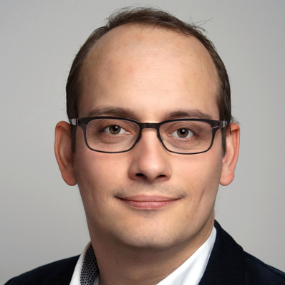
2024
International Graduate School on Control
www.eeci-igsc.eu
M02 ROME 04/03/2024-08/03/2024 | Dissipativity in Optimal Control - Turnpikes, Predictive Control, and Uncertainty
Lars Grune
University of Bayreuth
https://num.math.uni-bayreuth.de/ en/team/lars-gruene/
Timm Faulwasser
TU Dortmund
https://ie3.etit.tu-dortmund.de/ institute/team/tf/
Summary of the course
The optimal control twin breakthroughs, i.e. Pontryagin's maximum principle and Bellman's dynamic programming principle, and the dissipativity notion for open systems conceived by Jan. C. Willems are supporting pillars of systems and control. On this canvas, this course explores the constitutive relations between optimal control and dissipativity.
The week commences with a brief and example-driven introduction into optimal control formulations in continuous time and discrete time and we comment on the challenges that arise from infinite-horizon problems. We then turn towards dissipativity, discussing how optimal control has been at the very core of the concept since its inception. We comment on the surprisingly rich set of systems-and-control problems that admit a dissipativity-based analysis.
After this introduction we explore the turnpike phenomenon in optimal control – the first observations of which can be traced back to John von Neumann and Frank P. Ramsey. We discuss the deep link between dissipativity notions for optimal control problems and the turnpike phenomenon as well as the relation to the optimality system implied by the maximum principle.
Moving from open-loop to feedback considerations, we show how dissipativity helps to analyze the properties of receding-horizon approximations to infinite-horizon problems, i.e., we close the loop with model predictive control. Furthermore, we explore how the dissipativity-based framework can be extended to stochastic problems. Throughout the week our discussions are illustrated with examples from different application domains such as process control, mechanics, thermodynamics, and energy. Moreover, the students will conduct numerical experiments in class. The course concludes with an outlook on open problems and on ongoing research.

Slide 3

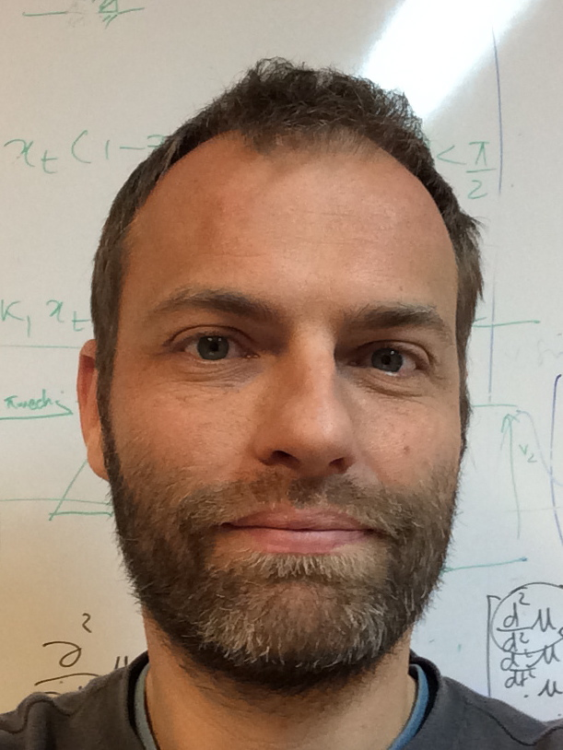
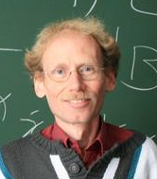
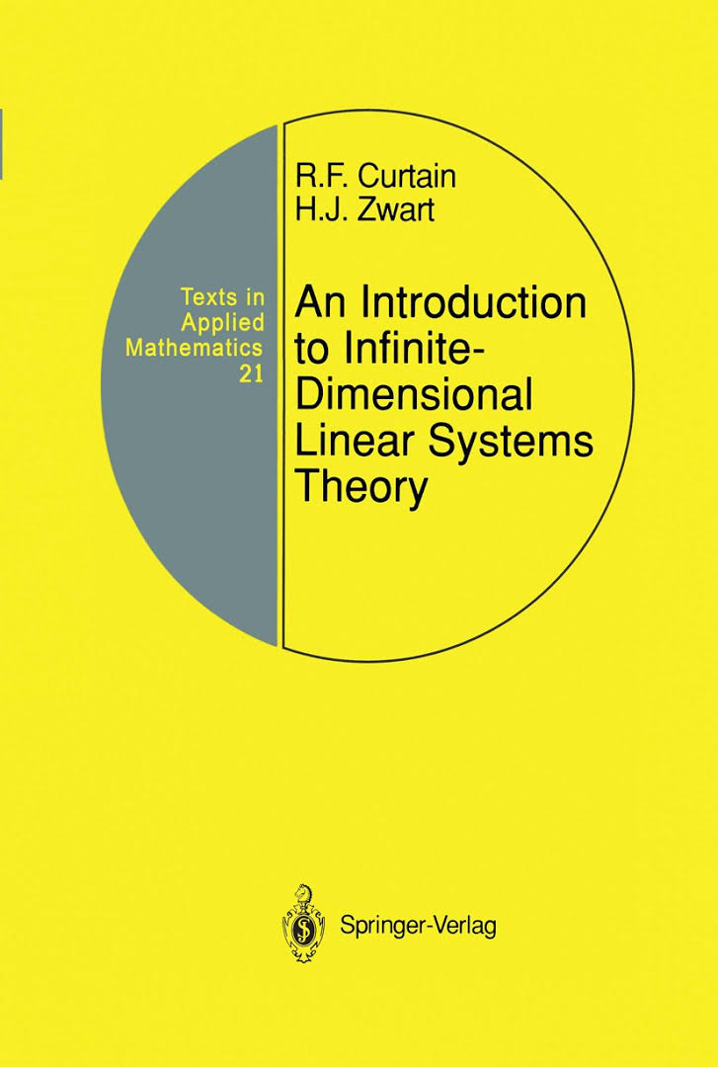
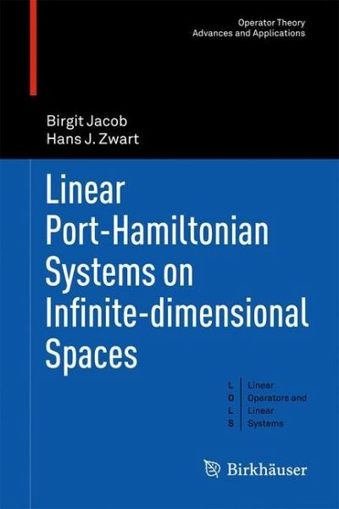
International Graduate School on Control
www.eeci-igsc.eu
M03 – BESANCON 8/04/2024-12/04/2024 | Modeling and control of distributed parameter systems: the Port Hamiltonian Approach
Yann Le Gorrec
SupMicroTech , France
http://legorrec.free.fr/wordpress/
Hans Zwart
University of Twente
The Netherlands
http://wwwhome.math.utwente.nl/~zwarthj/
Abstract of the course
This course presents a system control-oriented approach to modeling, analysis, and control of distributed parameter systems (DPS), i.e., systems governed by partial differential equations (PDEs). This class of systems is more and more encountered in cutting edge engineering applications due to the increased use of complex, heterogeneous and smart systems. Analysis and control of DPS is thus of high theoretical and practical interest, especially when considering the evolution of computing capacities that allows to deal with very high order systems. The formalism used in this course is the port-Hamiltonian framework. Well-known in control of nonlinear systems governed by ordinary differential equations, this formalism based on the concepts of energy and power exchanges has been extended to distributed parameter systems. The aim of this course is to show how this formalism can be advantageously used to study and control DPS. For instance, to derive simple (boundary) control laws for the stabilization of un-(or weakly) damped (linear) distributed parameter systems.
Topics
The first part of the course is devoted to modelling. More precisely, it focuses on the derivation of structured models accounting for power exchanges occurring within the system and with its environment. In the second part, existence of solutions, boundary control and stability of linear port-Hamiltonian systems are studied. The third part is concerned with control design. The course ends with a tutorial aiming at applying the different concepts on a practical and realistic example in order to illustrate with simulations the interest of such an approach. The different parts of this course are also illustrated through physical examples such as transmission lines, beam equations, linearized shallow water equations, Korteweg-de Vries equations, reaction-transport problems including chemical processes, population dynamics, etc.
Fig: Modeling, simulation and control of flexible nanotweezers for DNA manipulation
Target audience
This course is devoted to engineers and applied mathematicians looking for an introduction to the modelling and control of distributed parameters systems using the port-Hamiltonian framework.
http://events.femto-st.fr/MCDPS-PHS

Slide 4
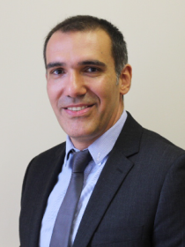
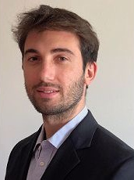
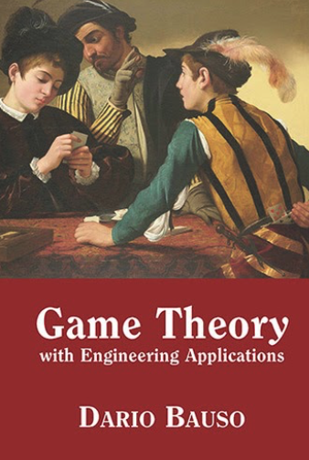
2024
International Graduate School on Control
www.eeci-igsc.eu
M04 BIRMINGHAM 15/04/2024-19/04/2024 | Game Theory with Engineering Applications
Dario Bauso
University of Groningen https://www.rug.nl/staff/d.bauso/
Leonardo Stella
Birmingham University
https://www.leonardostella.com/
Summary of the course
This course is an introduction to the fundamentals of cooperative and non-cooperative game theory. Motivations are drawn from engineered/networked systems (dynamic resource allocation, multi-agent systems, cyber-physical systems), and social models (including social and economic networks). The course emphasizes theoretical foundations, mathematical tools, modeling, and equilibrium notions in different environments.
Learning objectives:
Choose and implement the most appropriate models and methods to address competition in engineering systems
Analyse the performance measures and optimally design the inputs under deterministic or stochastic, known and unknown parameters of multi-agent systems and perform numerical analysis and design of small-scale examples on paper
Develop code using Python and MATLAB to perform numerical analysis and design on large-scale examples in game theoretic engineering applications
The course is organised in three main topic areas. • Noncooperative games • Cooperative games • Evolutionary games
D. Bauso affiliation: Since 2018 I have been with the Jan C. Willems Center for Systems and Control, ENTEG, Faculty of Science and Engineering, University of Groningen (The Netherlands), where I am currently Full Professor and Chair of Operations Research for Engineering Systems. Since 2005 I have also been with the Dipartimento di Ingegneria, University of Palermo.
L. Stella received the Laurea Magistrale degree (equivalent to MSc) in 2016 from Università La Sapienza, Italy, and the Ph.D. degree in 2019 from the University of Sheffield, UK. Since 2022, he is Assistant Professor in the School of Computer Science at the University of Birmingham (UK).

Slide 5
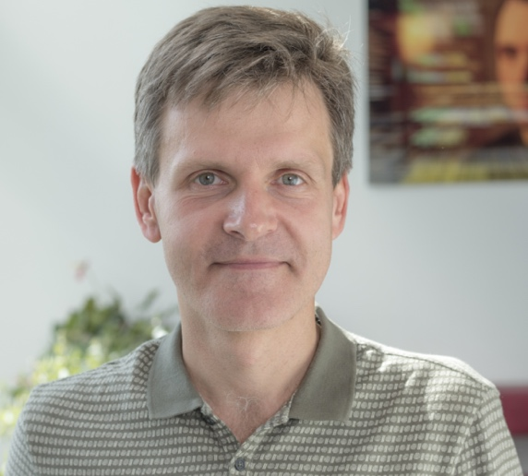
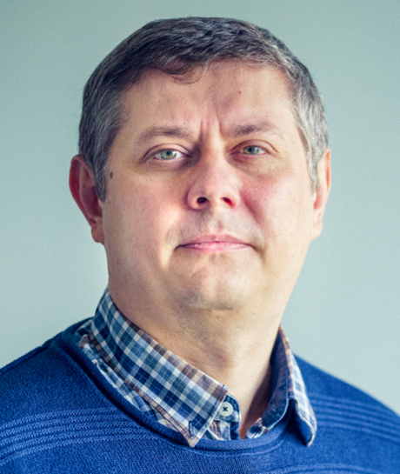
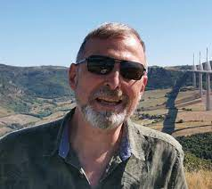
2024
International Graduate School on Control
www.eeci-igsc.eu
M05 – Nantes 22/04/2024-26/04/2024 | Introduction for finite-, fixed- and prescribed-time control and estimation
Denis Efimov
INRIA Lille
http://researchers.lille.inria.fr/ ~efimov/
Andrey Polyakov
INRIA Lille
http://researchers.lille.inria.fr/ ~efimov/
Jean-Pierre Barbot
ENSEA
https://www.quartz-lab.fr/ barbot-jean-pierre
Summary of the course
An introduction to basic results on analysis and design of finite/fixed-time and prescribed-time converging systems is given. Two main groups of approaches for analysis/synthesis of this kind of convergence, Lyapunov functions and the theory of homogeneous systems, are presented in details. The dynamics described by ordinary differential equations, time-delay models and partial differential equations are considered. Some popular control and estimation algorithms, which possess accelerated converge rates, are also surveyed. Finally, the issues of discretization of finite-/fixed/prescribed-time converging systems are discussed.
Topics
- concepts of accelerated convergence and stability - Lyapunov characterizations - homogeneous systems - robustness analysis and influence of delays - emergence of accelerated convergences in distributed-parameter systems - control and estimation algorithms with accelerated convergence - discretization and sampled-time implementation

Slide 6
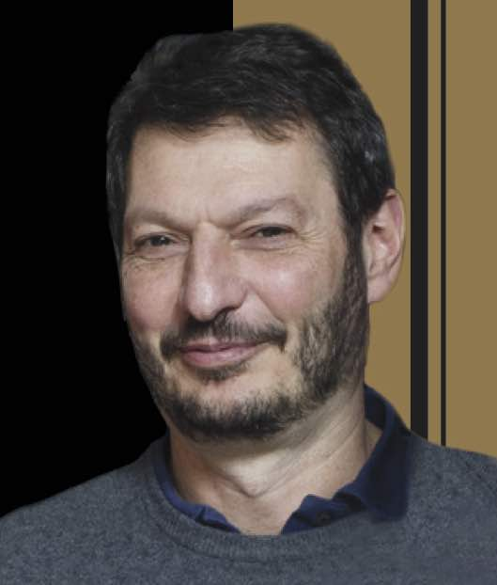
2024
International Graduate School on Control
www.eeci-igsc.eu
M06 TOULOUSE 29/04/2024-03/05/2024 | Sparsity and Big Data in Control, Systems Identification and Machine Learning
Abstract of the course
One of the hardest challenges faced by the systems community stems from the exponential explosion of data, fueled by recent advances in sensing technology. During the past few years a large research effort has been devoted to developing computationally tractable methods that seek to mitigate the ``curse of dimensionality" by exploiting sparsity.
The goals of this course are:
provide a quick introduction to the subject for people in the systems community faced with ``big data" and scaling problems, and
serve as a ``quick reference" guide for researchers, summarizing the state of the art .
Mario Sznaier
Electrical and Computer Eng.
Northeastern University,
Boston, USA
msznaier@coe.neu.edu
Part I of the course covers the issue of handling large data sets and sparsity priors in systems identification, model (in)validation and control. presenting recently developed techniques that exploit a deep connection to semi-algebraic geometry, rank minimization and matrix completion.
Part II of the course focuses on applications, including control and filter design subject to information flow constraints, subspace clustering and classification on Riemannian manifolds, and time-series classification, including activity recognition and anomaly detection.
Topics include:
Review of convex optimization and Linear Matrix Inequalities
Promoting sparsity via convex optimization. Convex surrogates for cardinality and rank
Fast algorithms for rank and cardinality minimization
Fast, scalable algorithms for Semi-Definite Programs that exploit sparsity
Sparsity in Systems Identification:
Identification of LTI systems with missing data and outliers
Identification of Switched Linear and Wiener Systems
Identification of sparse networks
Sparsity in Control: Synthesis of controllers subject to information flow constraints
Connections to Machine Learning: subspace clustering and manifold embedding
Applications: Time series classification from video data, fault detection, actionalble information extraction from large data sets, nonlinear dimensionality reduction, finding causal interactions in multi-agent systems.

Slide 7

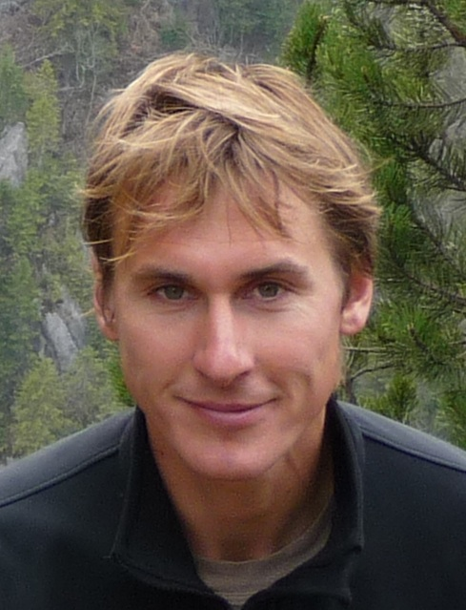
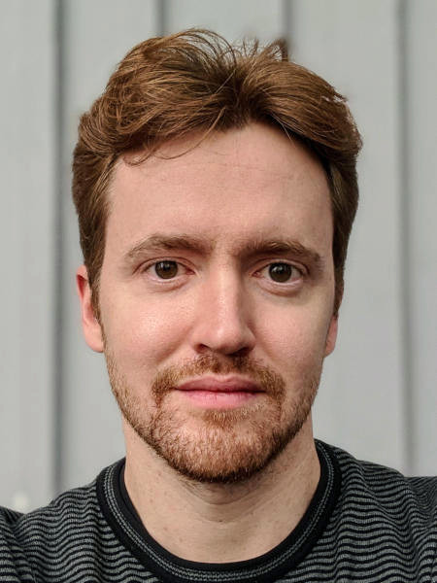
2024
International Graduate School on Control
www.eeci-igsc.eu
M07 – BARCELONA 06/05/2024-10/05/2024 | Data-Driven Operation of Autonomous Power Systems
Florian Dörfler
ETH Zurich
http://people.ee.ethz.ch/~floriand/
dorfler@ethz.ch
Saverio Bolognani
ETH Zurich
http://people.ee.ethz.ch/~bsaverio/
bsaverio@ethz.ch
Abstract of the course
The electric power system is currently undergoing a period of unprecedented changes. Centralized bulk generation based on fossil fuel and interfaced with synchronous machines is substituted by distributed generation based on renewables and interfaced with power converters. Accordingly, the entire system operation is undergoing several paradigm shifts spanning decentralized device-level control, distributed coordination of energy sources, and real-time system-level optimization. Further, classical decision-making methods are challenged by the lack of accurate models concerning system dynamics, loads, and low-voltage grids. In this course, we give a tutorial introduction into emerging thrusts in control and optimization of future autonomous power system with distributed generation. The solutions that we present rely on recent advances in data-driven and distributed control.
Topics: | - Basics of power system modeling, dynamics, analysis, & control - Decentralized control of converter-based resources in low-inertia systems - Online feedback optimization for power system operation - Data-driven approaches for control and real-time optimization - Co-design of automation and incentives for the procurement of grid services
Notes:
7

Slide 8
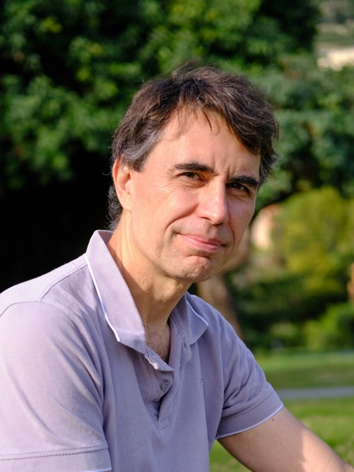
2024
International Graduate School on Control
www.eeci-igsc.eu
M08 – PARIS SACLAY 13/05/2024-17/05/2024 | Climbing the ladder: from nonlinear control to robot locomotion
Manfredi Maggiore
University of Toronto https://www.control.utoronto.ca/people/profs/maggiore/contact.php
Abstract of the course
Course description: this course presents recent developments on control of underactuated mechanical systems, focusing on the notion of virtual constraint.
Traditionally, motion control problems in robotics are partitioned in two parts: motion planning and trajectory tracking. The motion planning algorithm converts the motion specification into reference signals for the robot joints. The trajectory tracker uses feedback control to make the robot joints track the reference signals. There is evidence that this approach might be inadequate for sophisticated motion control problems, particularly ones related to robotic locomotion, in that reference signals impose a timing on the control loop which is unnatural and inherently non robust.
The virtual constraint technique does not rely on any reference signal, and does not impose any timing in the feedback loop. Motions are characterized implicitly through constraints that are enforced via feedback. Through judicious choice of the constraints, one may induce motions that are surprisingly natural and biologically plausible. For this reason, the virtual constraints technique has become a dominant paradigm in bipedal robot locomotion, and has the potential of becoming even more widespread in other area of robot locomotion.
The virtual constraint approach is geometric in nature. This course presents tools from nonlinear geometric control with emphasis on their applications to the motion control problem in robotics.
Topics
- Controlled invariant manifolds and zero dynamics of nonlinear control systems
- Euler-Lagrange robot models and hopefully models of impulsive impacts
- Virtual holonomic constraints (VHCs)
- Constrained dynamics resulting from VHCs, and conditions for existence of a Lagrangian structure
- Virtual constraint generators
- Stabilization of periodic orbits on the constraint manifold.
- Time permitting: Virtual constraints for walking robots

Slide 9
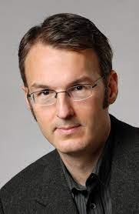
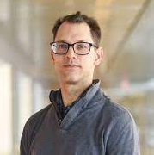
2024
International Graduate School on Control
www.eeci-igsc.eu
M09 STUTTGART 13/05/2024-17/05/2024 | Dissipation Inequalities and Quadratic Constraints for Control, Optimization, and Learning
Murat Arcak
University of California, Berkeley
https://www2.eecs.berkeley.edu/Faculty/Homepages/arcak.html
Peter Seiler,
University of Michigan, USA
https://seiler.engin.umich.edu/
Summary of the course
Lyapunov and dissipation inequalities play a central role in the numerical solution of many design and analysis problems in control theory. Quadratic constraints greatly enhance this theory by accommodating parametric and non-parametric uncertainty, including nonlinearities and unmodeled dynamics. This course focuses on the application of these methods to solve a variety of dynamical systems problems. First, we address systems with known dynamics and review basic Lyapunov and dissipativity theory to obtain stability and performance conditions, as well as reachable set characterizations for safety. Second, we introduce the quadratic constraint framework to describe uncertainties, and combine this framework with Lyapunov/dissipativity theory for robust stability, performance, and safety. Third, we introduce computational techniques for these analyses, such as semidefinite programming and sum-of-squares methods. Finally, we showcase the power of the methodology with a variety of case studies, including: (i) analysis of optimization algorithms, (ii) design and analysis of feedback systems with neural network controllers, and (iii) robustness analysis in flight control, power systems, and other applications. Numerical examples and code will be provided so that students can quickly integrate the methods into their own research.
Topics:
Dissipation inequalities, including Lyapunov inequalities and bounded real lemma
Quadratic constraints to describe model uncertainty
Combination of dissipation inequalities and quadratic constraints for robust stability, performance, and reachability analysis
Emerging applications in convergence analysis of optimization algorithms, stability and performance analysis of neural network controllers, flight control, power systems, etc.

Slide 10

2024
International Graduate School on Control
www.eeci-igsc.eu
M10 MONTPELLIER 20/05/202424/05/2024 | Control Of Biological Systems: From The Cell To The Environment
Aim of the course
The objective of this course is to give an introduction and cover recent aspects of dynamical modeling, monitoring and control of biological systems, including introduction to the metabolic engineering (the cell level), and modeling of ecological and epidemiological systems (the environmental level).
Denis Dochain,
UCLouvain, Belgium http://perso.uclouvain.be/denis.dochain/
The course will cover the following themes:
Dynamical modeling of biological systems: the notion of reaction networks and mass balance modeling will be introduced as a central concept to build a general dynamical model for biological systems. It will be used to model the biological system at the level of the cell (via the notions of metabolic engineering) up to the interaction mechanisms among different species (by considering microbial ecology notions).
The model will cover both homogeneous conditions, known as stirred conditions in reactors for instance (described by ODE’s (ordinary differential equations)) and non-homogeneous ones, encountered, e.g. in non-completely mixed reactors, such as plug flow and diffusion based conditions in reactors, as well as population balance models that describe the distribution of age or mass of the cells (described by P(I)DE’s (partial (integral) differential equations)).
Mathematical concepts of the general dynamical model, including reaction invariant, model reduction and stability will be studied in details.
The course will also cover the identification of bioprocess models (including the structural and practical model identifiability, and the design of optimal experiments for parameter estimation). It will also address simulation issues related to PDE models and the use of reduction methods for this type of models.
The microscopic dimension of the biological will be considered via metabolic engineering concepts in order to address the cell level of the biological system.
At the other end of the scale, (microbial) ecology and epidemiology concepts will be formalized via different modelling approach covering prey-predator and SIR models or the competitive exclusion principle.
In both cases, the link with key properties of reaction system models will be emphasized.
Monitoring: this part of the course will be dedicated to the design applications of state observers (Luenberger observers, Kalman filters, asymptotic observers, finite-time converging observers, …) and parameter estimation algorithms (in particular to estimate reaction rates and yield coefficients), that take advantage of the specific structural properties of the biological system models.
Control: the course will emphasize optimal control and (adaptive) linearizing control (including adaptive extremum seeking). The choice of these control approaches will be motivated in the context of biosystem applications.
Several practical applications will be used to illustrate the techniques and principles covered in this course. Examples will include biological systems from the food industry and the pharmaceutical industry to the environment and the (waste) water treatment. Computer hands-out exercices will be integrated in the course.

Slide 11
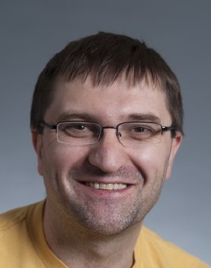
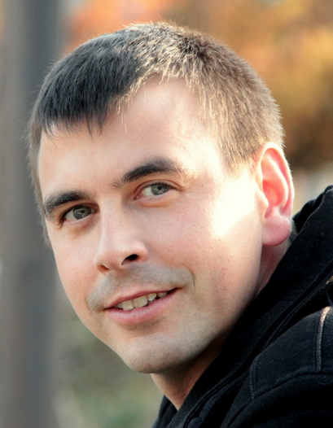
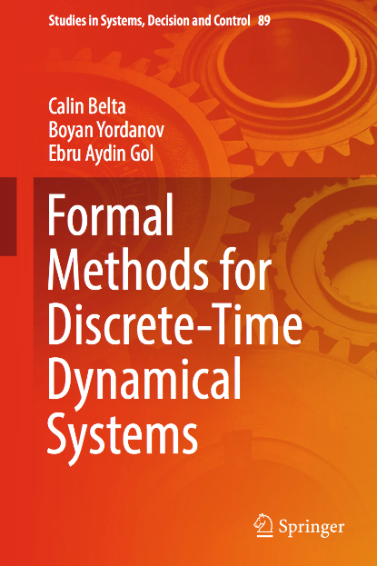
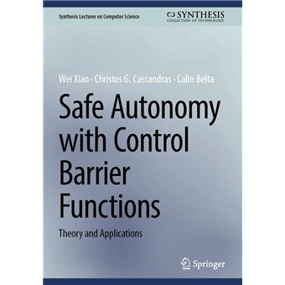
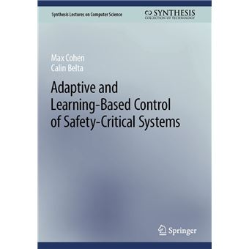
2024
International Graduate School on Control
www.eeci-igsc.eu
M11 – LEUVEN 27/05/2024-31/05/2024 | Formal Methods in Control Design: Abstraction, Optimization, and Data-driven Approaches
Calin Belta
Boston University
http://sites.bu.edu/hyness/calin/
Antoine Girard
CNRS
https://sites.google.com/site/antoinesgirard/
Summary of the course
In control theory, complicated dynamics such as systems of (nonlinear) differential equations are mostly controlled to achieve stability and to optimize a cost. In formal synthesis, simple systems such as finite state transition graphs modeling computer programs or digital circuits are controlled from specifications such as safety, liveness, or richer requirements expressed as formulas of temporal logics. With the development and integration of cyber physical and safety critical systems, there is an increasing need for computational tools for controlling complex systems from rich, temporal logic specifications. The main objective of this course is to present formal methods in control design. We will first present abstraction-based approaches. We will show how continuous dynamics can be formally related (using simulations, bisimulations, approximate bisimulations) to finite abstractions, how finite models can be controlled from temporal logic specifications, and how controllers for the abstractions can be refined into control strategies for the original continuous systems. We will then teach two optimization-based approaches. In the first, we will show how a constrained optimal control problem for a dynamical system with temporal logic specifications can be mapped to (mixed integer) linear or quadratic programs. In the second, we will enforce stability and temporal logic specifications using control barrier functions (CBF) and control Lyapunov functions (CLF). Finally, we will focus on systems with uncertain or unknown dynamics and will show how techniques from adaptive control and reinforcement learning can be used to enforce temporal logic requirements.
Outline
The need for formal methods in control design
Systems, behaviors and relations among them
Abstractions of continuous systems
3.1 Discrete abstractions: partition-based approaches, Lyapunov-based approaches, data-driven abstractions
3.2 Continuous abstractions
Abstraction-based controller synthesis
4.1 Safety, reachability, attractivity specifications: fixed-point synthesis, quantitative and robust synthesis, compositional synthesis
4.2 Linear temporal logic specifications: Finite temporal logic control, language-guided control systems, optimal temporal logic control
Optimization-based synthesis
5.1 Synthesis based on temporal logic quantitative semantics
5.2 Synthesis based on control barrier functions (CBF) and control Lyapunov functions (CLF)
6. Formal synthesis for systems with partially known and unknown dynamics
5.1 Data-driven synthesis using CBF and CLF
5.2 Automata-based approaches to safe and interpretable reinforcement learning

Slide 12
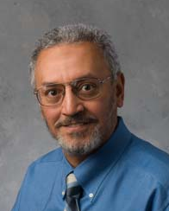
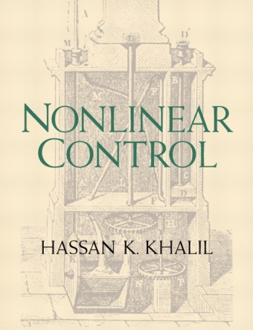
2024
International Graduate School on Control
www.eeci-igsc.eu
M12 SACLAY 03/06/2024-07/06/2024 | Introduction to Nonlinear Systems & Control
Abstract of the course
This is a first course in nonlinear control with the target audience being engineers from multiple disciplines (electrical, mechanical, aerospace, chemical, etc.) and applied mathematicians. The course is suitable for practicing engineers or graduate students who didn’t take such introductory course in their programs.
Prerequisites: Undergraduate‐level knowledge of differential equations and control systems.
Hassan Khalil
Dept. Electrical & Computer Engineering Michigan State University , USA
http://www.egr.msu.edu/~khalil/
Email: khalil@msu.edu
Outline
Introduction and second‐order systems (phase portraits; multiple equilibrium points; limit cycles)
Stability of equilibrium points (basics concepts; linearization; Lyapunov’s method; the invariance principle; region of attraction; time‐varying systems)
Perturbed systems; ultimate boundedness; input‐to‐state stability
Passivity and input‐output stability
Stability of feedback systems (passivity and small‐gain theorems; Circle & Popov criteria)
Normal and controller forms
Stabilization (linearization; feedback linearization; backstepping; passivity‐based control)
Robust stabilization (sliding mode control; Lyapunov redesign)
Observers (observers with linear‐error dynamics; Extended Kalman Filter, high‐gain observers)
Output feedback stabilization (linearization; passivity‐based control; observer‐based control; robust stabilization)
Tracking & regulation (feedback linearization; sliding mode Control; integral control)

Slide 13
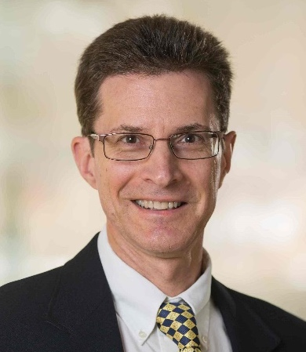
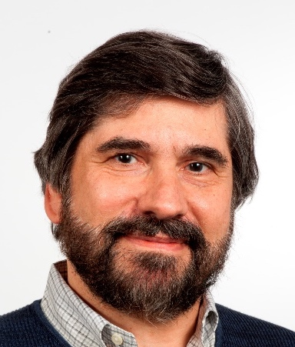
2024
International Graduate School on Control
www.eeci-igsc.eu
M13 – MARSEILLE 03/06/2024-07/06/2024 | Introduction to Discrete Event Systems
Stéphane Lafortune
University of Michigan
https://wiki.eecs.umich.edu/stephane/
Christos Cassandras
Boston University
https://christosgcassandras.org/
Course summary:
Discrete event systems are dynamic systems with discrete state spaces and event-driven dynamics. They arise when modeling the high-level behavior of cyber-physical systems or when modeling computing and software systems. Discrete event models can be purely logical, or they may include timing and stochastic information. This course will have two parts. In the first half, we will study logical discrete event systems, focusing primarily on automata models. We will consider estimation, diagnosability, and opacity analysis for partially-observed systems, then supervisory control under full and partial observation. In the second half, we will study the performance analysis, control, and optimization of timed DES, using stochastic timed automata models. We will describe the use of discrete event simulation and review elementary queueing theory and Markov Decision Processes used to study stochastic timed DES. We with then present Perturbation Analysis (PA) theory as a method to control and optimize common performance metrics for DES. Finally, we will explain how to extend DES into Hybrid Systems, limiting ourselves to basic modeling and simple extensions of PA theory.
No prior knowledge of discrete event systems will be assumed. The course will rely on the textbook co-authored by the instructors: Introduction to Discrete Event Systems – Third edition, Springer, 2021
https://www.springer.com/gp/book/9783030722722
Course outline:
1. Overview of DES and contrast to time-driven systems
2. Introduction to discrete event modeling formalisms
3. Analysis of logical discrete event systems
4. Supervisory control under full and partial observation
5. Timed Models of DES
6. DES (Monte Carlo) computer simulation
7. Review of queueing theory and Markov Decision Processes
8. Perturbation Analysis and Rapid Learning methods
9. From DES to Hybrid Systems

Slide 14
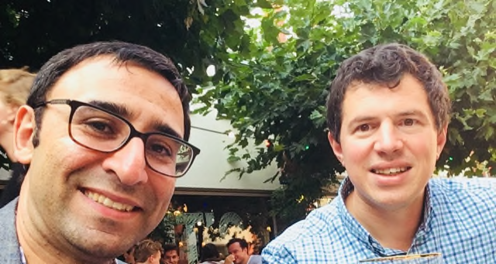

2024
International Graduate School on Control
www.eeci-igsc.eu
M14 - STOCKHOLM 10/06/2024-14/06/2024 | Gradient Flows and Optimization over Networks
Bahman Gharesifard
UCLA
https://gharesifard.github.io/
Julien Hendrickx
UCLouvain
https://perso.uclouvain.be/julien.hendrickx/
Summary of the course
Gradient-flow dynamics are at the forefront of numerous engineering and machine learning problems. Many algorithms utilizing gradient dynamics are large-scale, with computations being performed in a decentralized fashion over a network. This decentralization can be attributed to either information limitations or computational overhead in gradient computations. This course introduces the primary toolkit for designing and analyzing efficient decentralized optimization algorithms. We initiate the course by introducing the fundamentals of decentralized optimization problems, where individuals aim to find a common optimizer through local interactions over a network. We delve into both discrete and continuous-time dynamics, explore the effects of graph structures by providing a self-contained introduction to the basics of algebraic graph theory, and examine the impacts of uncertainty and randomness. A central focus will be on connecting the performance of distributed optimization methods to the features of the underlying network. The second part of the course will delve into fundamental limits in a broad class of distributed optimization algorithms and establish state-of-the-art worst-case performance bounds. We will also study issues of robustness and adversarial behaviors. In the final part of the course, we will concentrate on decentralized greedy algorithms for submodular optimization problems with limited information. These algorithms have found numerous recent applications, such as data summarization and selection problems in natural language processing, as well as sensor deployment in robotics..
Examples will be illustrated on Matlab.
Detailed Information will be provided on https://gharesifard.github.io/eeci2024-decentralized/
Outline
Decentralization in optimization and learning: an overview of the state-of-the-art
Consensus-based methods: deterministic and stochastic, with discrete and continuous-time dynamics
Worst-case studies and performance estimation for gradient dynamics
Fundamental limits in distributed computation and optimization
Robustness and resiliency in distributed optimization
Distributed submodular optimization

Slide 15
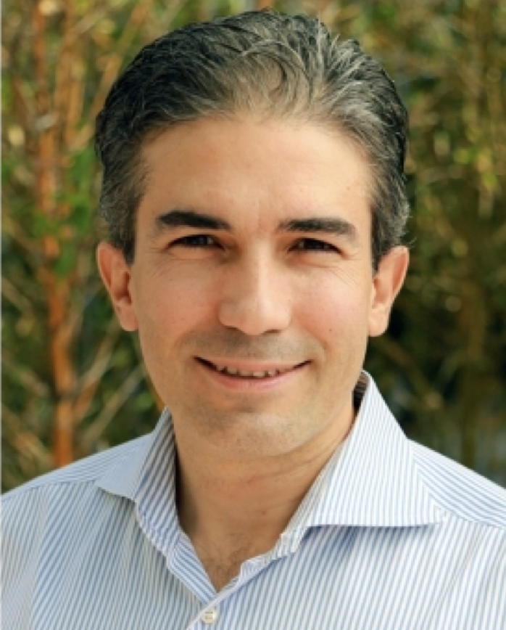
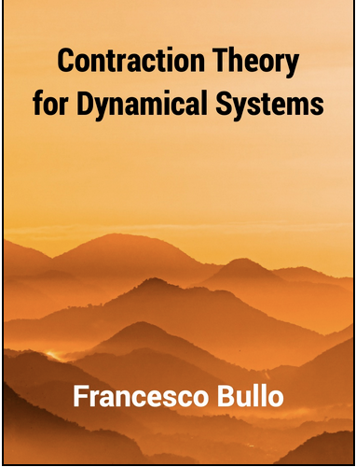
2024
International Graduate School on Control
www.eeci-igsc.eu
M15 PADOVA 11/06/2024-14/06/2024 | Theory and Applications of Contracting Dynamical Systems
Abstract
ABSTRACT: Over the last two decades, engineers and mathematicians have made remarkable progress on the application of the Banach contraction principle to dynamical systems over networks. The basic contraction property is now understood for discrete and continuous time systems, with respect to Euclidean and non-Euclidean norms, in closed and open systems, and for single agents and networks of systems. In this set of lectures, I will present this theoretical field and its applications. Topics will include
(i) the algebraic properties of the induced norms and logarithmic norms of matrices,
(ii) contracting dynamics over finite-dimensional vector spaces endowed with Euclidean and non-Euclidean norms,
(iii) weakly-contracting dynamics and monotone dynamics.
Numerous examples will be presented, including Hopfield neural networks, interconnected contracting systems, and gradient and primal/dual flows of convex functions.
REFERENCE: The reference text for the minicourse is the recent text "Contraction Theory for Dynamical Systems", KDP, v1.1, 2023, ISBN 979-8836646806, freely available at: https://fbullo.github.io/ctds
Francesco Bullo
UC Santa Barbara
https://fbullo.github.io

Slide 16
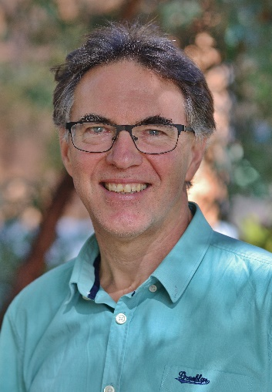
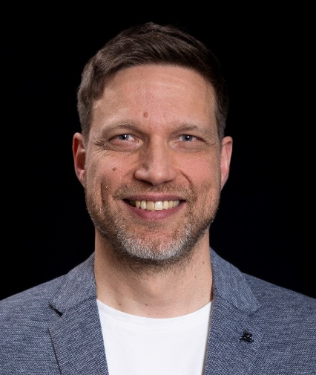
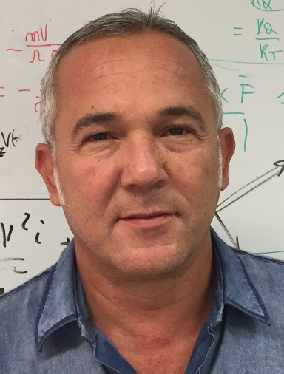
2024
International Graduate School on Control
www.eeci-igsc.eu
M16 – TRONDHEIM 17/06/2024-21/06/2024 | Equivariant observers: applications to autonomous systems
Robert Mahony
The Australian National University
http://users.cecs.anu.edu.au
/~Robert.Mahony/
Jochen Trumpf
The Australian National University
jochen.trumpf@anu.edu.au
Tarek Hamel
Université Côte d’Azur, France thamel@i3s.unice.fr
http://www.i3s.unice.fr/~thamel/
Abstract of the course
The operation of all autonomous systems depends critically on their ability to estimate their dynamic state. For high performance small-scale aerial, marine and terrestrial systems with limited sensor suites, highly dynamic motion, and limited computational capacity, the state observer performance is even more important. The role of symmetry as the fundamental structure needed to design the state-of-the-art observers and filters for autonomous systems has become accepted over the last decade and having an understanding is critical for student planning to work with the latest technology.
This course provides an introduction to the modern geometric theory underlying design of observers and filters for autonomous systems. The course provides a strong introduction to the tools of matrix calculus and matrix Lie groups from an engineering perspective. The modern theory of observer and filter design is taught through an extensive suite of case studies drawn from autonomous systems applications including; attitude estimation, velocity aided attitude estimation, inertial navigation systems, visual inertial odometry, and homography estimation. The course takes a hands on approach and students will learn the tools and techniques to derive and implement nonlinear observers and filters for real world robotic systems.
Topics: | 1) Perspectives on observer and filter design for physical systems. 2) Matrix calculus and matrix ODEs. 3) Lyapunov observer design for systems with matrix Lie group state. 4) Numerical implementation, measurement bias, and time delays. 5) Lie theory foundations, Kinematic systems with symmetry. 6) General theory of observer and filter design. 7) Overview of recent symmetry structures.
Algorithms for attitude estimation, homography estimation, velocity aided attitude estimation, inertial navigation systems (INS), and visual inertial odometry (VIO) will be covered in the course. Practical work in this course uses MATLAB (or equivalent scripting language such as Python) extensively. Students are required to have a working system on their own laptop for the course.

Slide 17
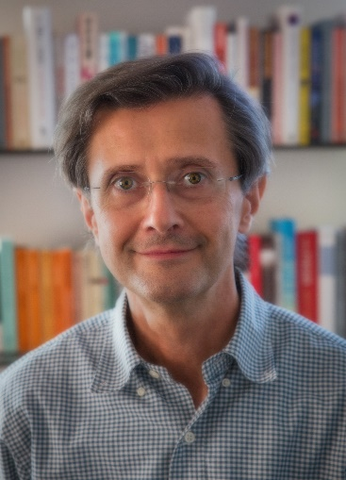
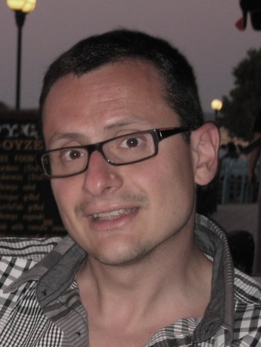
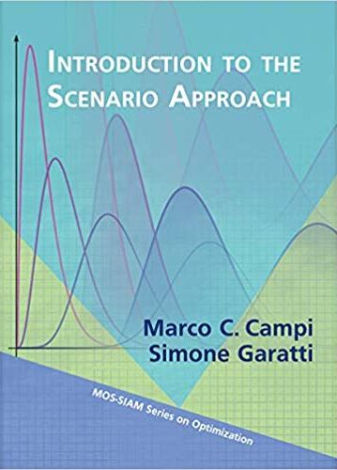
2024
International Graduate School on Control
www.eeci-igsc.eu
M17 OXFORD 24/06/2024-28/06/2024 | The scenario approach: data science for systems, control, and machine learning
Marco C. Campi
Department of Information Engineering
University of Brescia, Italy
http://marco-campi.unibs.it/
marco.campi@unibs.it
Simone Garatti
Dip. di Elettronica, Informazione e Bioingegneria
Politecnico di Milano, Italy
https://garatti.faculty.polimi.it/
simone.garatti@polimi.it
Abstract of the course
Data are ubiquitous in nowadays science and engineering. In this course, we introduce the “scenario approach”, which is a general methodology for data-driven decision making, and discuss its application to various fields (including machine learning and data-driven system design and control). We also present the most recent developments of its powerful generalization theory, which allows the user to tightly evaluate the out-of-sample robustness of the solution and keep control on the risk.
A gradual presentation of all the practical and theoretical aspects will allow for an easy comprehension of the material, while virtually no prior knowledge is required to follow the course.
Topics: | - Scenario Approach - Design in the presence of uncertainty Risk evaluation Application to systems, control and supervised learning - Presentation of open problems that offer an opportunity for research

Slide 18
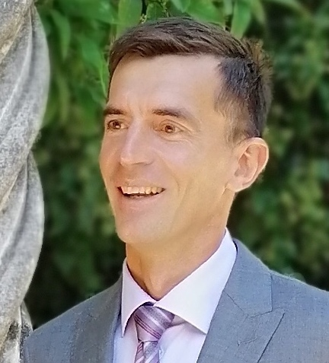

2024
International Graduate School on Control
www.eeci-igsc.eu
M18 DUBROVNIK 01/07/2024-05/07/2024 | Control and Machine Learning
Abstract
Control is a classical field in the intersection of Applied Mathematics and Engineering, arising in most applications to other sciences, industry and new technologies. Nowadays the field of Cont-rol experiences a revival due to its strong links with the broad and dynamic field of Machine Learning (ML). On the one hand, classical mathematical and computational methods developed in Control are complemented with new techniques emanating from ML, thus improving their performance. On the other hand, the, sometimes amazing, efficiency of the computational methods developed in ML, e.g. in Supervised and Reinforcement Learning, is not yet well understood analytically. And the knowledge accumulated over decades in the area of Control provides powerful tools to gain understanding.
This course is aimed to introduce some of the fundamental tools in control theory and machine learning and their computational counterparts, showing how they can be combined and employed to address applications efficiently, in an holistic manner, interrogating the know-how in each of these areas.
Martin Lazar
University of Dubrovnik
http://www.martin-lazar.from.hr/
about-me/
Outline:
Historical preliminaries
Control of linear finite-dimensional systems
The universal approximation theorem
Control formulation of supervised learning
Simulateneous controllability of neural differential equations
Width versus depth
Introduction to unsupervised learning
Introduction to federated learning
ML in control of parameter dependent systems
Turnpike, control and ML
Introduction to Physics-Informed Neural Networks (PINNs)
Solving differential equations by PINNs.
Enrique Zuazua
Friedrich-Alexander-Universität Erlangen-Nürnberg, Germany
enrique.zuazua@fau.de
Theoretical presentations will be combined with practical exercises in MATLAB.

